Slide 1
AI e Nuove Tecnologie
Luigi Piazza
Direttore U.O.C. di Chirurgia Generale e d’Urgenza, ARNAS Garibaldi Catania

Slide 2
Artificial Intelligence in Bariatric Surgery
Ask the Artificial Intelligence
Future Perspectives

Slide 3
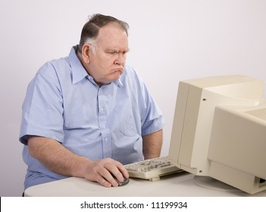
Online health information frequently suffers from content inaccuracy and suboptimal quality
Patients often turn to online informational resources to educate themselves about health-related matters. The overall quality of online information related to bariatric surgery has been reported to be poor and consequently a barrier to increased uptake of surgery for obesity
This survey study highlights the potential of ChatGPT as a high-quality informational resource for patients relative to bariatric surgery
Majority of responses were deemed to be “Very Good” or “Excellent,” and 90% of the experts believed that the generated responses were comparable, to a certain extent, to practicing clinicians
Moazzam et al., Obesity Surgery (2023) 33:2611–2614

Slide 4
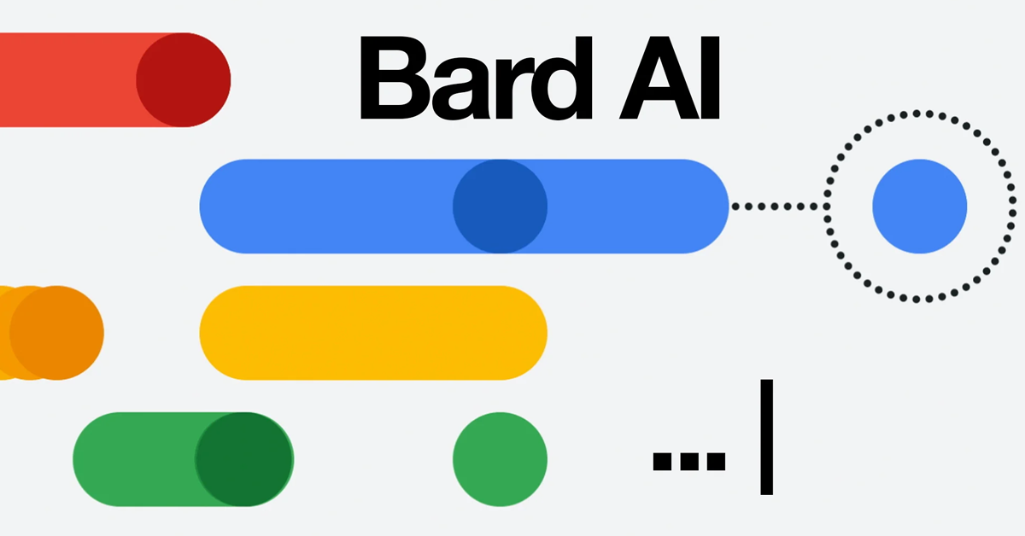
Over the last few years, the surge in electronic messaging has led to increased after-hours work for physicians. As such, incorporation of a LLMs in this context could mitigate this workload and reduce rates of physician burnout
Especially advantageous for patients who rely on messaging and telemedicine due to demographic or socioeconomic barriers
It is crucial to maintain ongoing training and refinement of AI models to improve the precision of their responses. A clinician’s oversight remains essential to validate the accuracy of AI-generated advice
Our study found that the AI LLMs provided answers that were overall considered “difficult” to read
Overall, our study demonstrates that AI-based chat models exhibit promise in potentially enhancing physician workflow by providing meaningful answers to clinical queries in the field of bariatrics.
Yung Lee et al., Surgery for Obesity and Related Diseases -(2024) 1–6

Slide 5
It’s important to note that the use of ChatGPT for bariatric assessment has not yet been thoroughly investigated or studied. It is hypothesized that GPT-4 will be capable of performing preoperative evaluation and surgical planning similar to that performed by human experts.
In this study, we intend to evaluate GPT-4’s competency in detecting patient suitability for bariatric surgery and recommending optimal surgical approaches.
VS
Jazi et al., Obesity Surgery (2023) 33:3971–3980

Slide 6
We found crucial shortcomings in ChatGPT-4’s ability to accurately assess patient scenarios, despite the initial promise of its use in patient education and potential assistance for healthcare professionals. Expert panel opinions diverged from AI recommendations in several instances, most notably when understanding patient histories and risk factors was vital to choosing the appropriate surgical intervention.
The AI were only 30% consistent with the opinions of the expert panel
ChatGPT lacks access to information beyond August 2021. This limitation hinders the ability of large language models to provide pertinent information to medical professionals
VS
Jazi et al., Obesity Surgery (2023) 33:3971–3980

Slide 7
Artificial Intelligence in Bariatric Surgery
Ask the Artificial Intelligence
Future Perspectives

Slide 8
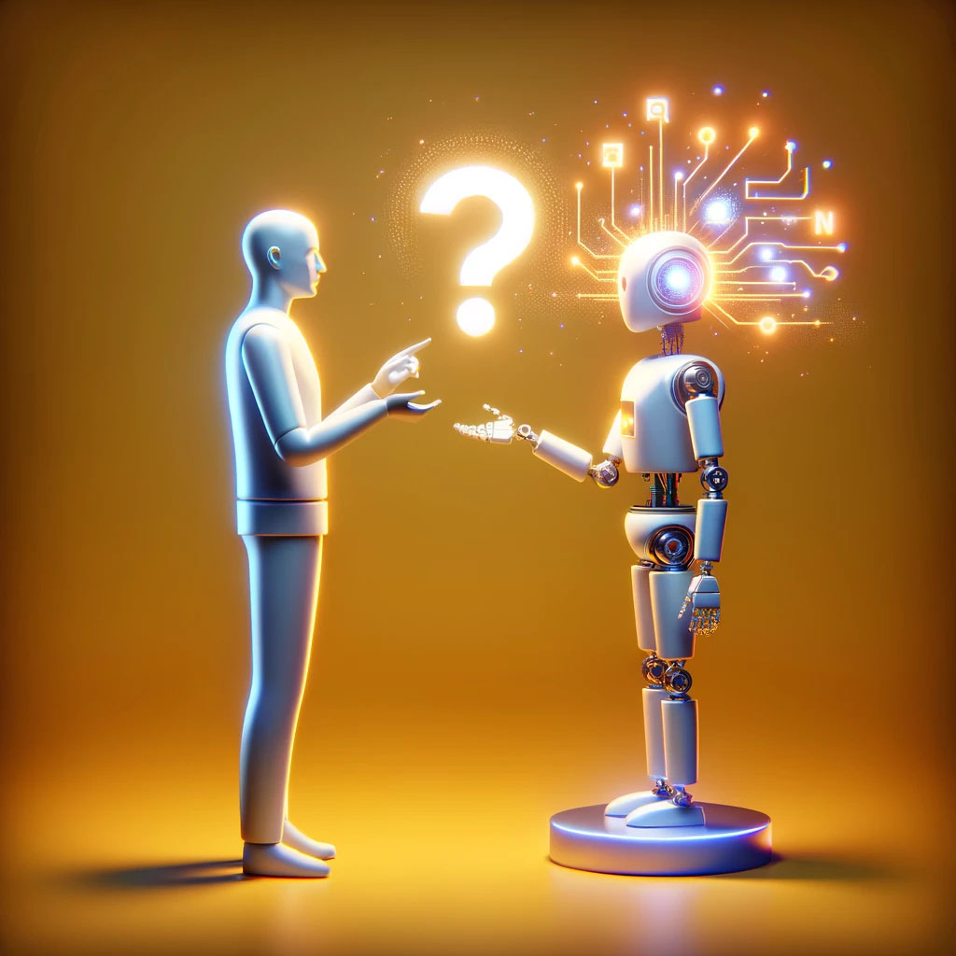
Ask the Artificial Intelligence
Paziente
Che cos’è la chirurgia dell’obesità?
Quali sono le indicazioni alla chirurgia dell’obesità?
La chirurgia dell’obesità curerà il mio diabete/ipertensione arteriosa/apnee notturne?
Posso dimagrire solo con la dietà?
Quale tipo di intervento chirurgico bariatrico fa per me?
Quanto dimagrirò dopo la chirurgia dell’obesità?
Dovrò seguire una dieta ed eseguire esercizio fisico dopo chirurgia dell’obesità?
Riprenderò peso dopo la chirurgia dell’obesità?
E’ possibile fare un secondo intervento di chirurgia dell’obesità se si riprende peso?
La chirurgia dell’obesità è reversibile?
E’ necessario sempre prendere multivitaminici a vita dopo chirurgia dell’obesità?
Quanto dura l’intervento chirurgico di chirurgia dell’obesità?
Posso rimanere incinta dopo chirurgia dell’obesità?
Quali sono le complicanze della chirurgia dell’obesità?
Quando posso ritornare a lavoro dopo la chirurgia dell’obesità?

Slide 9
Ask the Artificial Intelligence
Medico Medicina Generale
Quale intervento tra la Sleeve Gastrectomy e il Bypass Gastrico è più efficace per la perdita di peso?
In che modo il Bypass Gastrico ad unica anastomosi differisce dal Bypass Gastrico?
C’è differenza tra la chirurgia bariatrica laparoscopica e robotica?
Per quanto tempo bisogna continuare la terapia con inibitori di pompa protonica post chirurgia bariatrica?
Qual’è il miglior approccio nella gestione della fistola dopo Sleeve Gastrectomy?
Quali sono i rischi di malnutrizione dopo chirurgia bariatrica?
Quale integrazione è necessaria dopo Sleeve Gastrectomy/Bypass Gastrico?
Qual’è il miglior modo di gestire la ripresa di peso dopo chirurgia bariatrica?
Quali sono le indicazioni a chirurgia bariatrica per gli adolescenti/anziani?
Quali sono gli esami da eseguire prima della chirurgia bariatrica?

Slide 10
Ask the Artificial Intelligence
Team Bariatrico
Caso Clinico 1
Uomo Età: 48 BMI: 37,6
APR: dislipidemia in terapia con statinici, fumatore attivo (20 pacchetti/anno)
EGDS: sono state osservate aree di eritema a chiazze nell'antro gastrico. La mucosa gastrica restante appare normale. È stata eseguita una biopsia. Risultati coerenti con la metaplasia intestinale nell'antro gastrico. Nessuna evidenza di displasia o malignità osservata.
Caso clinico 2
Donna Età: 26 BMI: 28
APR: apnea notturna
Sforzi per perdere peso (metodi non chirurgici): nonostante gli sforzi per perdere peso attraverso regolare esercizio aerobico, l'individuo rimane irremovibile alla volontà di essere sottoposto a chirurgia bariatrica
Anamnesi familiare: la madre ha avuto obesità e diabete
EGDS: normale, è stata eseguita una biopsia e il referto patologico non ha mostrato anomalie

Slide 11
Ask the Artificial Intelligence
Team Bariatrico
Caso Clinico 3
Donna Età: 37 BMI: 36
APR: endometriosi disseminata in terapia con pillola contraccettiva orale, ipertensione,
Storia chirurgica pregressa: la paziente ha subito diverse laparotomie e resezioni intestinali a causa di significative aderenze causate dall'endometriosi disseminata
EGDS: normale, è stata eseguita una biopsia e il referto patologico non ha mostrato anomalie
Caso clinico 4
Uomo Età: 38 BMI: 61
APR: BPCO, diabete, reflusso gastroesofageo sintomatico, grave apnea notturna che richiede terapia con BiPAP, e steatosi epatica non alcolica di primo
EGDS: si notano erosioni ed eritema che coinvolgono meno del 50% della circonferenza esofagea, suggerendo un'esofagite di grado B
Biopsia della mucosa esofagea: esofagite cronica attiva con caratteristiche suggestive di esofagite da reflusso

Slide 12
Artificial Intelligence in Bariatric Surgery
Ask the Artificial Intelligence
Future Perspectives

Slide 13
Potential improvements that can result from future studies
Weight loss outcomes exhibit variability and unpredictability, likely attributable to technical variations in procedures. To achieve the most effective results, we advocate for the establishment of optimal ratios or values tailored to individual patient characteristics, by compiling technical information obtained from video recordings of laparoscopic and robotic surgeries and harmonizing them with the results
The ongoing revolution in artificial intelligence is reshaping medical practices
Robust prediction models for the remission of comorbidities should be developed.
The impact of lifestyle, genetic background, and other patient-related factors on outcomes warrants detailed exploration. Digitization and technological solutions that automate data retrieval are essential to meet the challenge of adding data regularly (wearables and mobile apps will play a pivotal role in this process)
Increased predictability of side effects (gastroesophageal reflux disease or gallstones), can aid in procedure selection and postoperative precautions
Sisik et al., Individualized Bariatric Surgery Utilizing Artificial Intelligence: A Call to Colleagues and New Year’s Aspiration Obesity Surgery (2024) 34:1380–1381

Slide 14
Take Home Messages
AI-based chat models hold significant potential to serve as an effective tool in delivering timely and relevant information to questions arising in bariatric surgery. While AI models are not intended to replace human expertise, they could be integrated to augment clinical practice, enhancing efficiency and accessibility of information for both healthcare professionals and patients.
To improve the accuracy and consistency of the model, and to realize its potential value in the complex and highly individualized field of bariatric surgery, continued research, development, and collaboration with medical experts are necessary
Collaboration between clinicians and data scientists is crucial for deriving conclusions from these intricate datasets
Through collaborative efforts, the marriage of precision medicine and AI holds the promise of revolutionizing the landscape of obesity treatment

Slide 15
Take Home Messages
AI-based chat models hold significant potential to serve as an effective tool in delivering timely and relevant information to questions arising in bariatric surgery. While AI models are not intended to replace human expertise, they could be integrated to augment clinical practice, enhancing efficiency and accessibility of information for both healthcare professionals and patients.
To improve the accuracy and consistency of the model, and to realize its potential value in the complex and highly individualized field of bariatric surgery, continued research, development, and collaboration with medical experts are necessary
Collaboration between clinicians and data scientists is crucial for deriving conclusions from these intricate datasets
Through collaborative efforts, the marriage of precision medicine and AI holds the promise of revolutionizing the landscape of obesity treatment

Slide 16
Take Home Messages
AI-based chat models hold significant potential to serve as an effective tool in delivering timely and relevant information to questions arising in bariatric surgery. While AI models are not intended to replace human expertise, they could be integrated to augment clinical practice, enhancing efficiency and accessibility of information for both healthcare professionals and patients.
To improve the accuracy and consistency of the model, and to realize its potential value in the complex and highly individualized field of bariatric surgery, continued research, development, and collaboration with medical experts are necessary
Collaboration between clinicians and data scientists is crucial for deriving conclusions from these intricate datasets
Through collaborative efforts, the marriage of precision medicine and AI holds the promise of revolutionizing the landscape of obesity treatment

Slide 17
Take Home Messages
AI-based chat models hold significant potential to serve as an effective tool in delivering timely and relevant information to questions arising in bariatric surgery. While AI models are not intended to replace human expertise, they could be integrated to augment clinical practice, enhancing efficiency and accessibility of information for both healthcare professionals and patients.
To improve the accuracy and consistency of the model, and to realize its potential value in the complex and highly individualized field of bariatric surgery, continued research, development, and collaboration with medical experts are necessary
Collaboration between clinicians and data scientists is crucial for deriving conclusions from these intricate datasets
Through collaborative efforts, the marriage of precision medicine and AI holds the promise of revolutionizing the landscape of obesity treatment

Slide 18
Grazie

